Slide 1

Visual Learning through algorithms
Azher Taimur

Slide 2

What is visual learning ?
Visual learning is a style in which a learner utilizes graphs, charts, maps and diagrams. It is one of the three basic types of learning styles in the Fleming VAK/VARK model that also includes kinesthetic learning and auditory learning

Slide 3
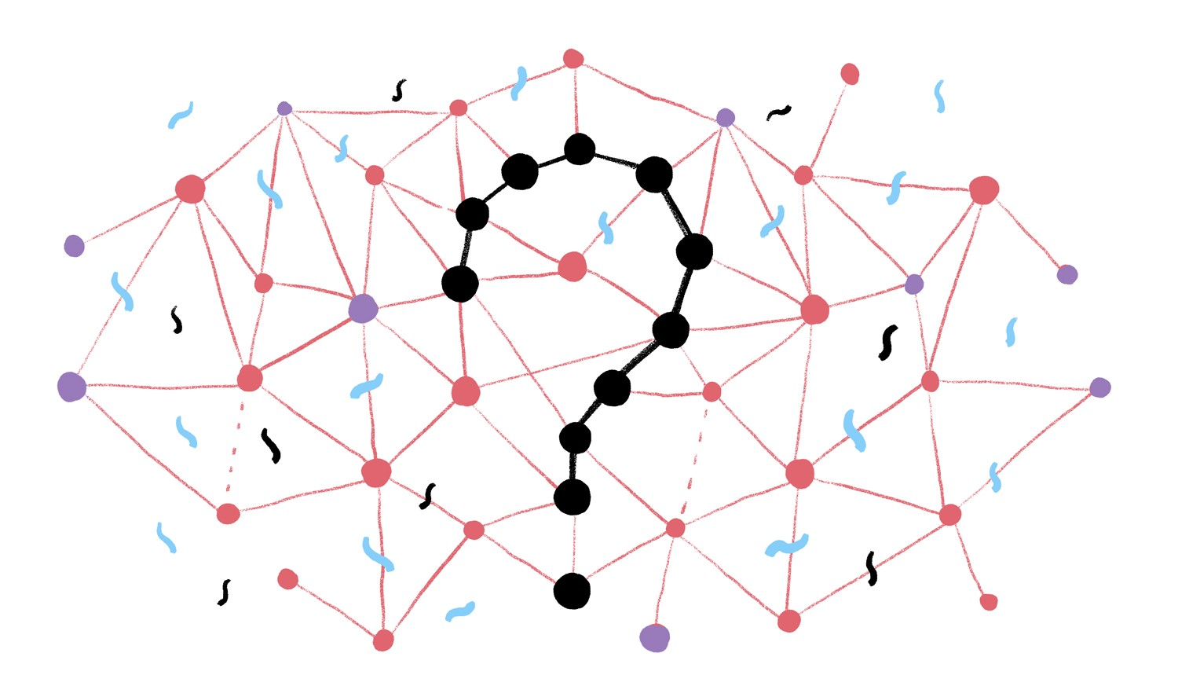

Where does programming come in ?
Algorithms
Fractals

Slide 4
How does this help with problem solving?
Problem solving
Define problem
Specify causes
Gather data
Brainstorm possible alternatives
Plan and implement test
Evaluate short term results
Plan how to maintain and monitor
Evaluate long term results
Algorithms
Set out the process
Set the rules to be followed
What is the desired end result ?
Implement

